Slide 1
Unix System Administration
Unit 10:
  backup
  restore

Slide 2
Asking Initial Questions
What files should be backed up?
  Where are files located?
How should backups be performed?
  Who will back up files?
Restore requirements ?
  within a specific period of time?

Slide 3
Backup Media
What kind ?
Storage ?
  onsite vs. offsite
How many units ?
  consider levels

Slide 4
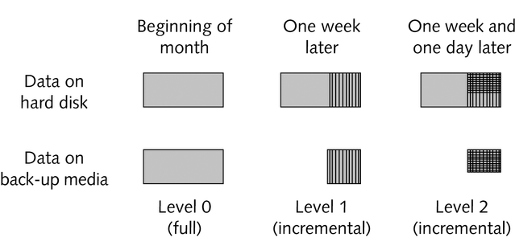
Backup Levels

Slide 5
Restore
Individual file
  Check level 2, then 1, then 0
Full restore
  Restore level 0, then 1, then 2

Slide 6
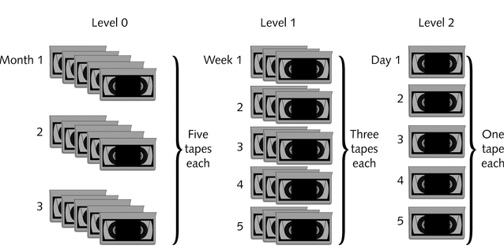
media provisioning

Slide 7
backup procedure
create archive files
  directly onto media
  via file
backup commands
  dump, tar and cpio
  also: find command

Slide 8
dump/restore
dump options
  level (0 is full backup, others are increments)
  destination:
    file or device
  u (update /etc/dumpdates)
restore options
  f (source)
  t (list), i (interactive)
  r (restore file system), x (extract file)

Slide 9
dump/restore examples
dump -0uf /dev/st1 /
dump -1uf /tmp/backup /home
restore -if /dev/st1
restore -xf /tmp/backup etc/crontab

Slide 10
tar
create archive:
tar zcvpf /archive/backup.tar.gz
--exclude=*.iso
--exclude=tmp
--exclude=bufferdir /home
restore from backup:
tar zxvf backup.tar.gz path-to-file

Slide 11
cpio
example:
find . -mtime -1 -print |
cpio -o -H crc > backup-file
also:
cpio -i “pattern” < backup-file
format

Slide 12
cpio formats
bin The obsolete binary format (default).
odc The old (POSIX.1) portable format.
newc The new (SVR4) portable format, which supports file
systems having more than 65536 i-nodes.
crc The new (SVR4) portable format with a checksum added.
tar The old tar format.
ustar The POSIX.1 tar format. Also recognizes GNU tar
archives, which are similar but not identical.
hpbin The obsolete binary format used by HPUX’s cpio (which
stores device files differently).
hpodc The portable format used by HPUX’s cpio (which stores
device files differently).

